Slide 1
Multiple Regression Part 2 Using RStudio for Ag Data
STAT 441/541 Statistical Methods II

Slide 2

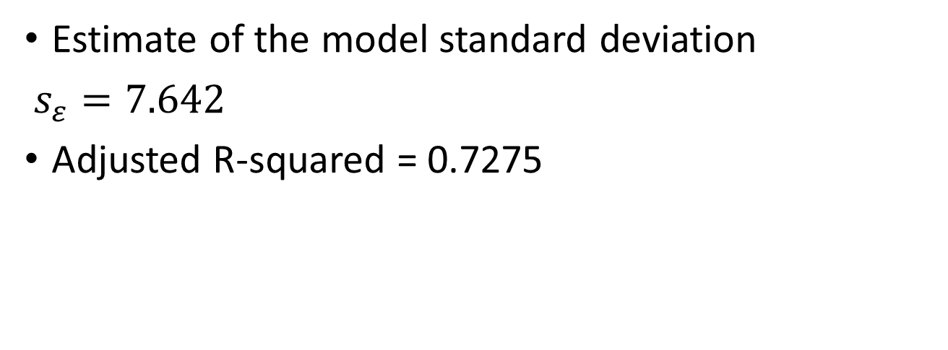
Information in the Model Summary Table
Estimate of the model standard deviation
$s_{ε}=7.642$
Adjusted R-squared = 0.7275

Slide 3

Assess Multicollinearity
The Variance Inflation Factor for independent variable x6 is 1.75
The Variance Inflation Factor for independent variable x9 is 1.75

Slide 4
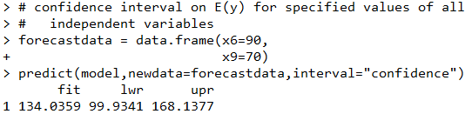
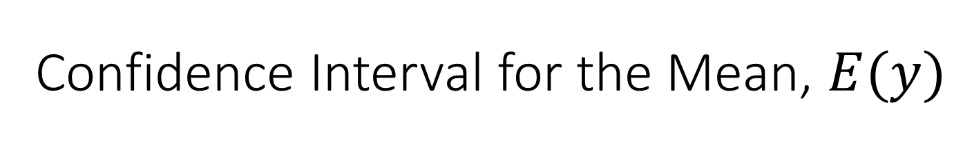
Confidence Interval for the Mean, $E(y)$
The predicted value when x6=90 and x9=70 is 134.04
The lower confidence limit is 99.93 and the upper confidence limit is 168.14 when x6=90 and x9=70

Slide 5

Prediction Interval for Individual Values of y
The predicted value when x6=90 and x9=70 is 134.04
The lower prediction limit is 96.61 and the upper prediction limit is 171.46 when x6=90 and x9=70

Slide 6
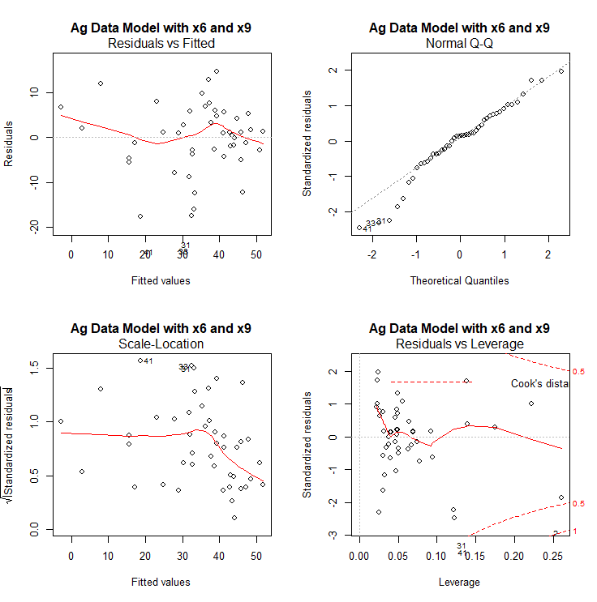
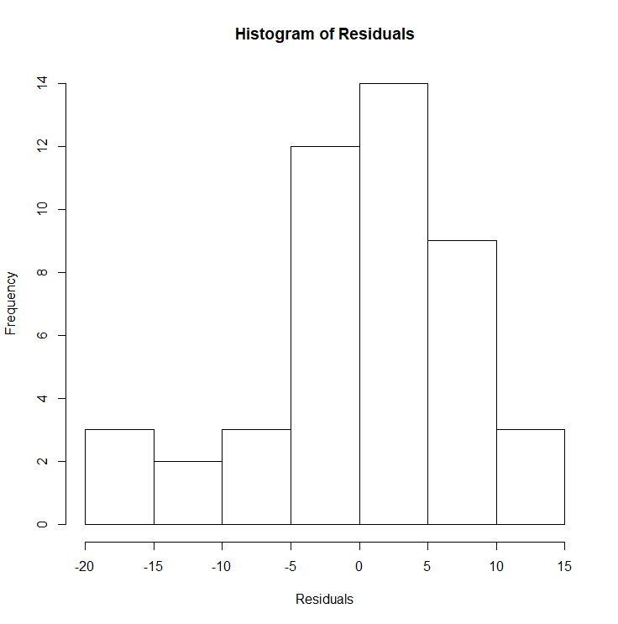
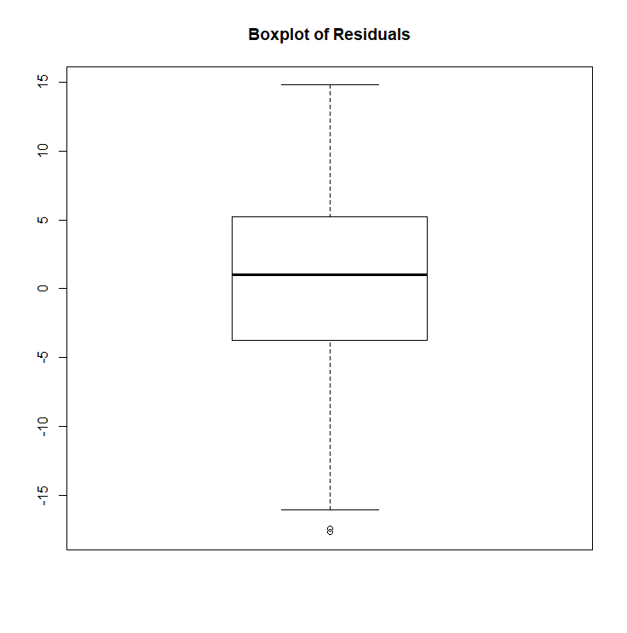
Various Diagnostic Plots for Checking Assumptions

Slide 7
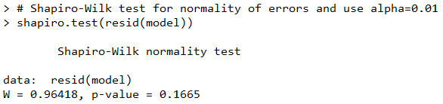
Shapiro-Wilk Test
Test Statistic

Slide 8
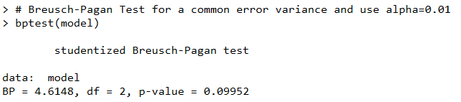
Breusch-Pagan Test
Test Statistic

Slide 9
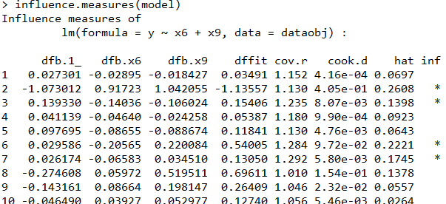
Potential Outliers
dfbetas
Observations flagged as influential

